Slide 1

Home Security and Surveillance System by- Tech Rangers
Presented By:
<Shubham Kumar> <04751202819>
<Harshit Pandey> <05551202819>
<Aahn deshpande> <00151202818>
<Chirag kaushik> <01351202819>

Slide 2

Purpose
All in one security system for a general household.
Detects theft and emergency situations.
Text message directly on phone.
Far better than conventional security solutions.
No chances of human error.

Slide 3

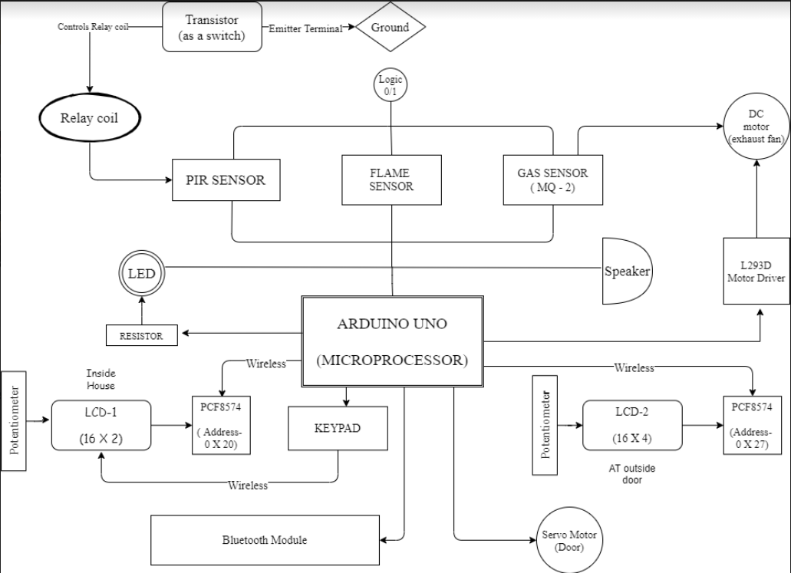
Block Diagram

Slide 4
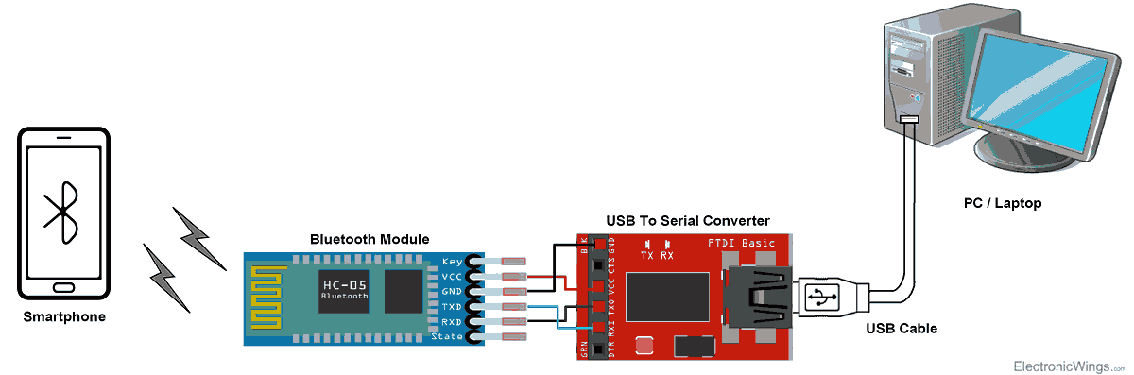
Bluetooth module
HC-05 is a Bluetooth module which is designed for wireless comunication
It uses serial communication to communicate with devices. It communicates with microcontroller using serial port (USART).

Slide 5
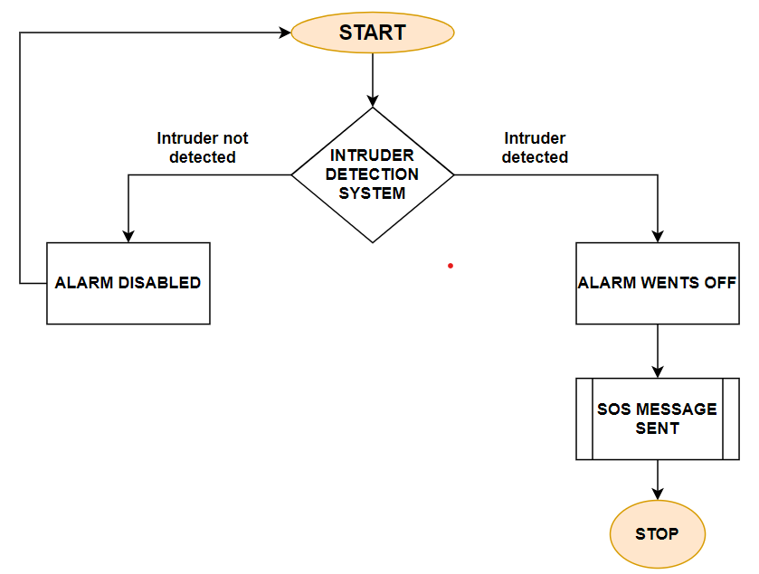
Intruder Detection System
Passive Infrared Sensor is used as motion detector.
SOS message sent upon intrusion.
Option to turn On/Off PIR sensor.

Slide 6
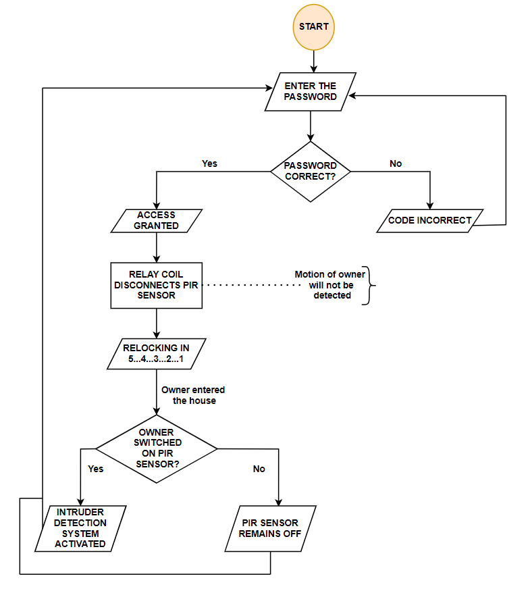
Door Lock Mechanism
CASE 1
Person enters correct password.
Transistor as switch---> activates relay coil ---> deactivate PIR sensor
CASE 2
Person enters incorrect password→ PIR sensor remains on.

Slide 7
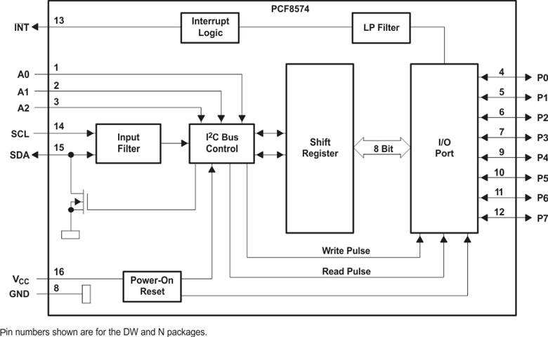
PCF8574
This is 8-bit input/output (I/O) expander for the two-line bidirectional bus (I²C)
2.5-V to 6-V V_{CC} :- operation range
At power on, the I/Os are high. In this mode, only a current source to V_{CC} is active.

Slide 8
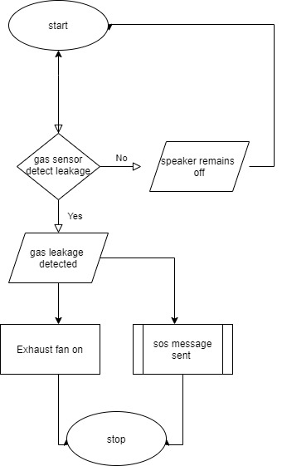
Gas sensor
Case 1:
If gas leakage is detected then exhaust fan is turned on and sos message is sent to mobile phone
Case 2 :
If gas leakage is not detected then process is repeated

Slide 9
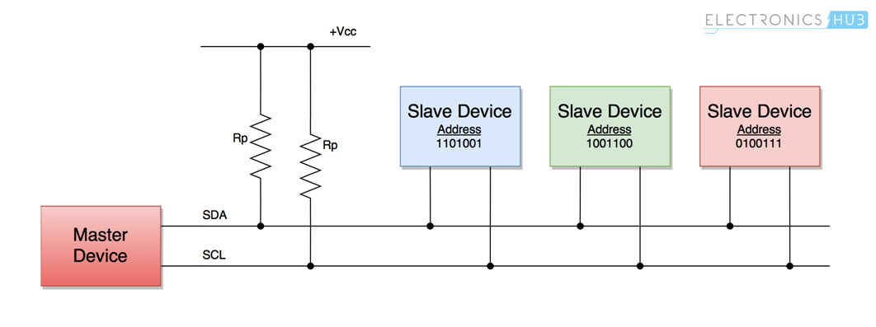
I2C Bus Communication Protocol
I2C stands for inter integrated circuit.
It transfers data between central processor and multiple ICs.
Only two common bus lines or wires are required to control ant device.
The two bus lines are:
SDA(Serial data)
SCL(Serial clock )

Slide 10
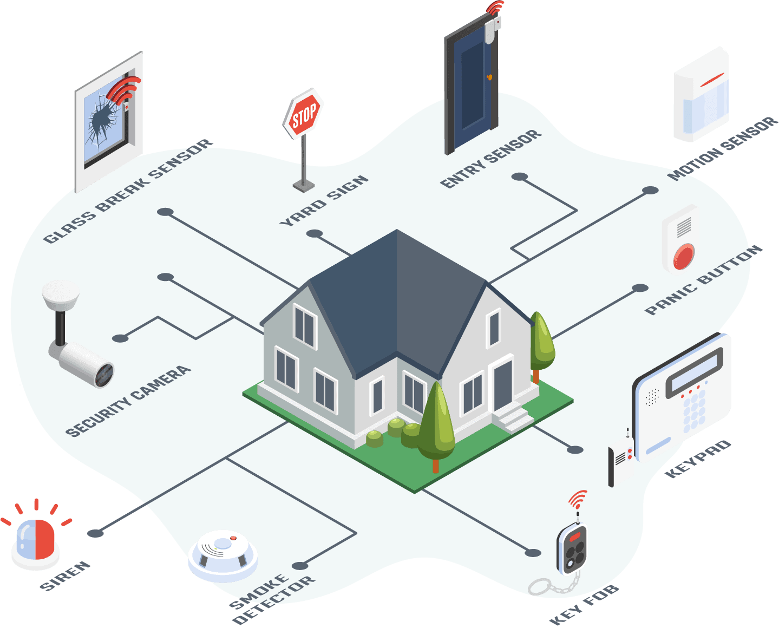
Future Scope
.
Use of GSM to increase the range.
Installation of smart surveillance camera
Add voice assistant for senior citizen and blind people.
Connect an emergency button with nearby police

Slide 11

Applications
Using surveillance system to prevent theft.
For providing safety to our property and life.
It allows remote access to our home and offices.
Use in Banks to enhance the security.

